Slide 1




EXHAUSTIVE ANALYSIS OF INDIAN AGRICULTURE SECTOR USING POWER BI
Name : Himanshu Kundan Tapde

Slide 2

Learning Objectives
Exploratory Data Analysis :
Analyze crop production trends over the years using Power BI to identify growth patterns and anomalies.
Identify Top Crops :
Determine top crops based on production volume, area, and yield, analyzing contributing factors.
Seasonal Analysis :
Analyze crop production by season (Kharif, Rabi) to understand seasonal impacts.
GOAL
Source :
www.freepik.com/

Slide 3
State/District Analysis :
Analyze crop production at the state and district levels to identify regional disparities.
KPI Identification :
Define and track KPIs (yield, production volume, diversification) using interactive dashboards.
Business Insights :
Extract meaningful insights from the data to understand drivers of crop production and identify improvement opportunities at state, district, crop, and area levels.
GOAL

Slide 4
Tools and Technology used
Power BI :
A powerful business analytics tool that enables data visualization and the creation of interactive dashboards. It allows for the analysis of agricultural data to derive insights and monitor Key Performance Indicators (KPIs) related to crop production, yield, and other metrics.
Microsoft Power Query :
A data connection technology that facilitates the transformation and preparation of data for analysis. It enables users to clean, reshape, and combine data from various sources, ensuring that the data is in a suitable format for use in Power BI.

Slide 5
Tools and Technology used
(Extract, Transform, Load): The overall process of moving data.
Extract: Gathering data from diverse sources.
Transform: Cleaning, converting, and standardizing the data.
Load: Loading the transformed data into a target system (like a data warehouse).
Data Transformation: The process of converting data into a usable format
Data Cleaning: Ensuring data is high-quality and accurate.

Slide 6
Methodology
1)Identify Data Sources: Gather diverse agricultural data from sources like Kaggle and other sites.
2)Import & Connect: Import dataset into Power BI, connecting via spreadsheets and databases.
3)Transform with Power Query: Clean and reshape data using Power Query, preparing it for analysis.
4)Build Dashboards: Create tailored dashboards in Power BI to monitor key performance indicators (KPIs).
5)Real-Time Integration: Integrate live data streams for timely responses to changing conditions.
6)Explore & Visualize: Use Power BI visuals to uncover patterns and relationships in the data.
7)Define KPIs: Calculate relevant metrics like yield per hectare to measure performance.
8)Trend Analysis: Identify production trends over time to inform adjustments.
9)Comparative Analysis: Compare crop yields across regions to guide resource allocation.
10)Report & Share: Summarize insights and share dashboards for data-driven decisions.

Slide 7
Problem Statement:
The problem statement of the project is that it aims to conduct a comprehensive analysis of Indian agriculture, focusing on district-wise and year-wise data.
The dataset provides detailed information on various crops, their areas, production, and yields across different districts and years.
The goal is to leverage Power BI to create interactive visualizations that uncover trends, patterns, and disparities in agricultural practices, enabling stakeholders to make informed decisions for sustainable farming and resource allocation.

Slide 8
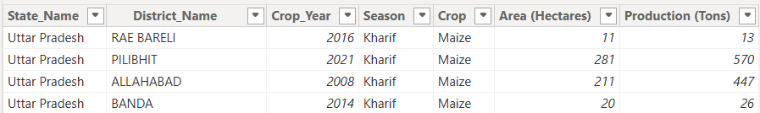
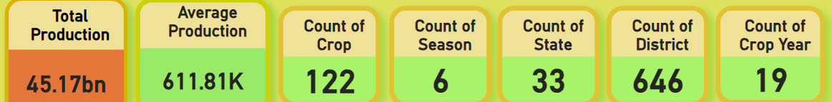
Solution:
Dataset Overview :
Area : The land area used for cultivating a crop measured in (Hectares).
Production : The quantity of crop harvested from cultivated area measured in (Tons).

Slide 9
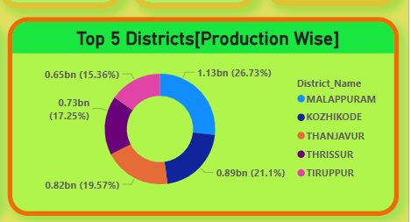
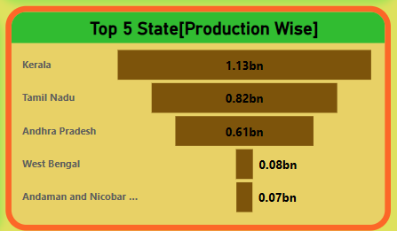
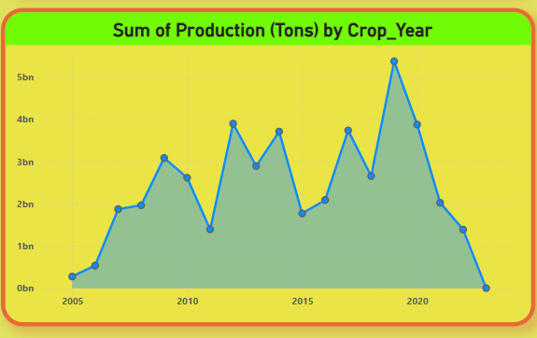
Solution:
Major Crop Analysis:
1) Bar Charts: Visualize the top 5 states and districts in rice, wheat, and pulses production, enabling quick comparison of production volumes.
2) Line Charts: Display production trends of major crops over time, highlighting growth patterns and seasonal variations.

Slide 10
Solution:
1. 𝐏𝐫𝐨𝐝𝐮𝐜𝐭𝐢𝐨𝐧 𝐛𝐲 𝐘𝐞𝐚𝐫𝐬
•1995: Production was 850 million units. 2011: Production increased to 14.3 billion units, representing a 1,582% increase from 1995. 2014: Production decreased to 8.66 billion units, reflecting a 39.44% decrease from 2011.
2. 𝐏𝐫𝐨𝐝𝐮𝐜𝐭𝐢𝐨𝐧 𝐛𝐲 𝐒𝐭𝐚𝐭𝐞
• 𝐊𝐞𝐫𝐚𝐥𝐚: Total Production: 97.88 billion Highest producer
• 𝐀𝐧𝐝𝐡𝐫𝐚 𝐏𝐫𝐚𝐝𝐞𝐬𝐡: TP: 17.32 billion Second highest producer.
• 𝐓𝐚𝐦𝐢𝐥 𝐍𝐚𝐝𝐮: TP: 12 billion Third highest producer
3. 𝐏𝐫𝐨𝐝𝐮𝐜𝐭𝐢𝐨𝐧 𝐛𝐲 𝐃𝐢𝐬𝐭𝐫𝐢𝐜𝐭
• 𝐊𝐨𝐳𝐡𝐢𝐤𝐨𝐝𝐞: TP: 15.28 billion Highest producer
• 𝐌𝐚𝐥𝐚𝐩𝐩𝐮𝐫𝐚𝐦: TP: 14.52 billion Second highest producer
• 𝐓𝐡𝐢𝐫𝐮𝐯𝐚𝐧𝐚𝐧𝐭𝐡𝐚𝐩𝐮𝐫𝐚𝐦: TP: 10 billion Third highest producer
4. 𝐏𝐫𝐨𝐝𝐮𝐜𝐭𝐢𝐨𝐧 𝐛𝐲 𝐒𝐞𝐚𝐬𝐨𝐧𝐬
• Highest Producer: 𝐂𝐨𝐜𝐨𝐧𝐮𝐭 (129 billion)
• Second Highest: 𝐒𝐮𝐠𝐚𝐫𝐜𝐚𝐧𝐞 (3.75 billion)
• Third Highest: 𝐏𝐨𝐭𝐚𝐭𝐨 (200 million)

Slide 11
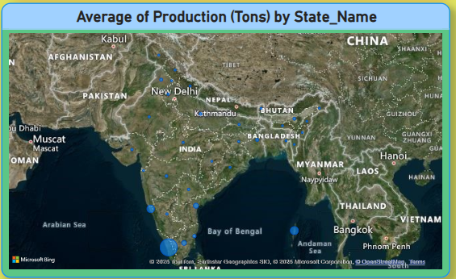
Solution:
State Analysis:
1) Geographic Heat Maps: Illustrate state-wise crop cultivation patterns and production levels, visually identifying regional strengths and weaknesses.
2) Cards: Present key performance indicators (KPIs) such as total production, average yield, or area under cultivation.

Slide 12
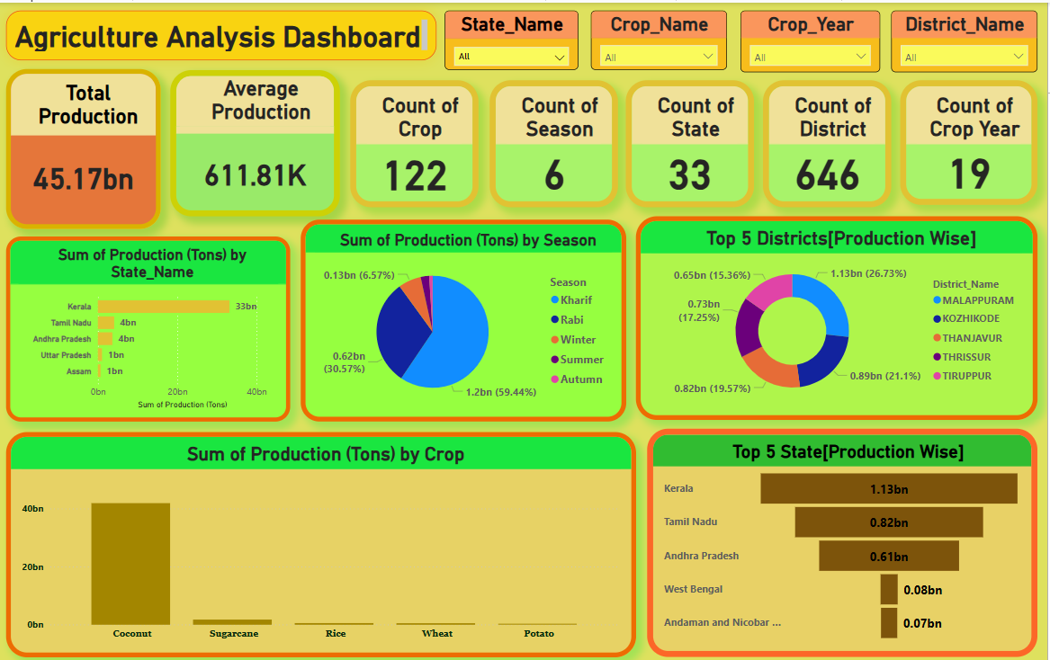
Screenshot of Output:

Slide 13
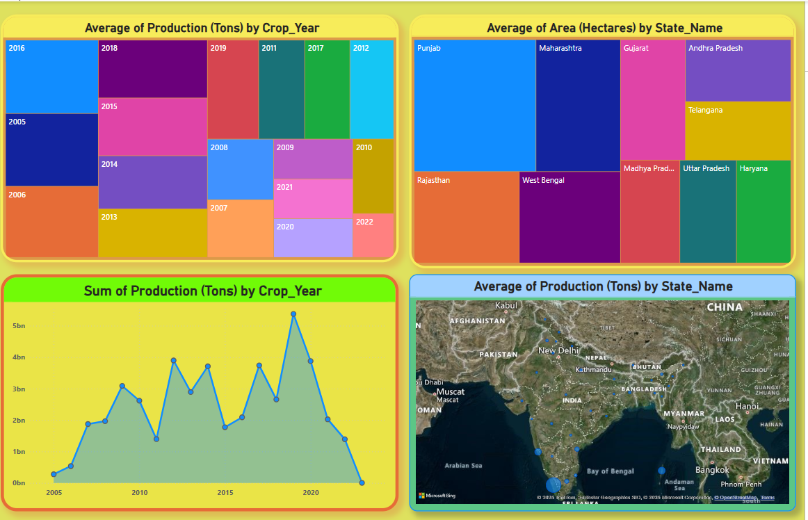
Screenshot of Output:

Slide 14
Conclusion:
In conclusion, this Power BI analysis of the Indian agriculture sector provides stakeholders with a powerful tool for informed decision-making. By visualizing key trends, regional disparities, and crop-specific performance metrics, the interactive dashboard empowers users to identify areas for improvement, optimize resource allocation, and develop targeted interventions to enhance agricultural productivity and sustainability. The insights derived from this analysis can contribute to more effective policy formulation and support the long-term growth of the Indian agricultural economy.

